Slide 1
Ensemble Stacking and Optimisation For Annual Revenue Prediction of Individual Airbnb Hosting: Italy
Presentation(Research Project)
Junghyun Min(x20103352)
M.Sc. Data Analytics
Notes:
Hi, My name is 정현 and my project will get started about Ensemble Stacking and Optimisation For Annual Revenue Prediction of Individual Airbnb Hosting in Italy

Slide 2
Overview of presentation
Introduction
Project Background and Motivation
Research Question
Objectives
Literature Reviews
Methodology and Process Workflow
Data Source and Preprocessing
Explanatory Data Analysis and Visualisation
Feature Selection
Implementation
Base learners
Mata learner(XGBoost)
Ensemble Stacking
Bayesian Optimisation
Genetic Algorithm
Evaluation and Results
Discussion and Conclusion
Future Work
References
Notes:
This is the overview of presentation and This presentation will follow this order of the overview listing.

Slide 3
Research Questions
RQ: How are the ensemble machine learning techniques predict the profitability through the Italian Airbnb data and what optimisation method is optimal with the best ensemble technique?
Sub-RQ: How is the relationship explainable between the profitability of 10 regions in Italy and which factors affect the profitability formation mostly?
Because the data was collected from 10 cities, it allows for observing the differences for example how the cities can be identified respectively with profitability patterns. By identifying factors affecting profitability, this project on Airbnb can also contribute to referencing features that should be considered for home purchases and B&B investments in the future
Notes:
Research Questions have main Research Question and sub Research Question.
First one is ~~, Second one is ~~.
At the end of the presentation, these will be mentioned again to check how was the RQs covered through the project.
Because the data was collected from 10 cities, it allows for observing the differences for example how the cities can be identified respectively with profitability patterns. By identifying factors affecting profitability, this project on Airbnb can also contribute to referencing features that should be considered for home purchases and B&B investments in the future

Slide 4
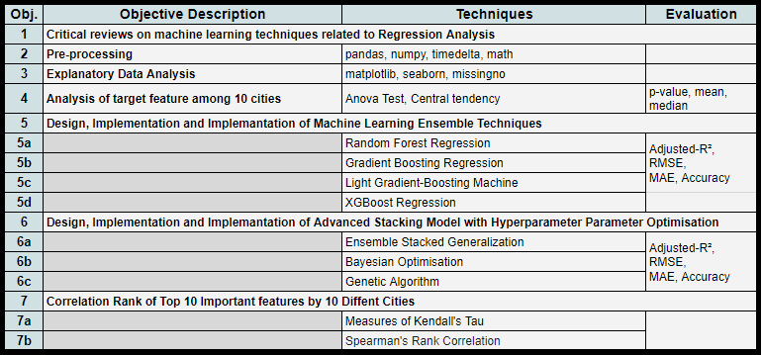
Research Project Objectives
Notes:
Project Objectives are consist of 7 objectives.
Critical related work reviews / Preprocessing / Explanatory Data Analysis / ANOVA test for the target feature/ Implementation and Evaluation of Ensemble single models/ Implementation and Evaluation of Ensemble stacking combined to hyperparameter optimisation/ And lastly Covering the sub RQ using Rank correlation.

Slide 5
Introduction
Project Background and Motivation
Air travel traffic recovered post-Covid-19.
Italy is a top global travel destination.
B&B businesses such as Airbnb are essential to the travel industry.
As Airbnb rapidly grew since its 2009 founding, it has benefited both tourists and locals through a reliable platform.
The project used various ensemble models combined with hyperparameter optimisation for Airbnb profitability prediction.
Analysis included data from 10 Italian cities, assessing factors influencing profitability.
Notes:
Air travel traffic recovered post-Covid-19 and B&B businesses such as Airbnb are essential to the travel industry.
Since Italy has been one top global travel destinations, The project used various ensemble models combined with hyperparameter optimisation for Airbnb profitability prediction.

Slide 6
Literature Review(1/4)
Machine Learning and Neural Network for Housing Price Prediction
Zhang (2021): Explored factors affecting housing prices using multiple linear regression and Spearman’s correlation. Suggested future improvement of the model's generalizability.
Jamil et al. (2020) and Khosravi et al. (2022): Employed various ML techniques for price prediction, and compared linear models with Ridge and Lasso regression. Found Decision Tree and Random Forest Regressor to perform best.
Phan (2018): Used Melbourne property data with Stepwise, PCA, and various models. Neural Network had the highest error, Stepwise and SVM combination showed competitive potential.
Wu and Yang (2022): Used Miami Housing Dataset with SVR, Linear Regression, Random Forest, Neural Network, and XGBoost. Ensemble methods, particularly Random Forest and XGBoost, outperformed other models.
Notes:
Literature Review, first keyword.Machine Learning and Neural Network for Housing Price Prediction
It used be using linear regression models for price prediction and after the use of more advanced machine learning techniques increased and performed better.

Slide 7
Literature Review(2/4)
Ensemble Machine Learning Technologies used for Housing Price
Shahhosseini et al. (2020): Proposed optimization model for ensemble learners minimizing bias and variance. Demonstrated competitive performance in house price prediction on Boston and Ames datasets.
Mora-Garcia et al. (2022): Evaluated machine learning algorithms for COVID-19 impact on Spanish house prices. Used k-fold cross-validation, random and Bayesian search. XGBoost with binning performed exceptionally well.
Jha et al. (2020): Employed XGBoost, CatBoost, Random Forest, Lasso, and Voting Regressor algorithms on a five-year dataset. Binning-incorporated XGBoost showed superior performance in various metrics.
Notes:
Literature Review, second keyword. Ensemble Machine Learning Technologies used for Housing Price
In housing price prediction studies, the ensemble technique emerged as a bullish trend.

Slide 8
Literature Review(3/4)
Ensemble Stacking Methods used for Regression Models
Meharie et al. (2022): Proposed stacking ensemble model with RF, GB, LGB, and XGBoost as meta-learner for better accuracy and stability. Showed stacking's superior performance over individual models.
Graczyk et al. (2010): Explored six ML algorithms in WEKA with Additive Regression Analysis, Bagging, and Stacking. Stacking yielded the lowest prediction errors, especially enhancing LRM, M5R, and RBF ensembles.
Cao et al. (2018): Constructed California housing price model using ET, RF, GBDT, and XGB through Stacking. Improved prediction accuracy and mitigated overfitting with noisy data.
Liu et al. (2021): Introduced stacking model with Bagging, Extra-Trees, XGBoost, and LightGBM. Outperformed individual models, especially in predicting extreme values.
Notes:
Literature Review, Third keyword. Stacking Methods used for Regression Models
Ensemble Stacking showed more amazing performances than single boosting models.

Slide 9
Literature Review(4/4)
Hyperparameter Optimisation Techniques
Liu (2021): Used various ML models for Airbnb pricing, XGBoost performed best with R^2 score of 0.6321, followed by Gradient Boosting.
Mora-Garcia et al. (2022): Utilized hyperparameter optimization with random and Bayesian search, achieving the best results for different models.
Lahmiri et al. (2023): Employed Bayesian optimization to find optimal parameters for boosting ensemble regression, support vector regression, and Gaussian process regression.
Yang and Shami (2020): Incorporated Bayesian optimization within cross-validation, boosting ensemble regression trees showed superior performance.
Luat et al. (2021): Used Genetic Algorithm (GA) to find optimal hyperparameters for eXtreme Gradient Boosting (XGB), outperforming ANN model.
Mansoori et al. (2023): Employed Hyperparameter Optimization (HPO) to enhance Length of Stay prediction in Iranian hospitals, XGBoost combined with GA improved performance.
Notes:
Literature Review, last keyword. Hyperparameter Optimisation.
Random search and Bayesian search have been used the most and sometimes Genetic Algorithms were studied to boost their performances.

Slide 10
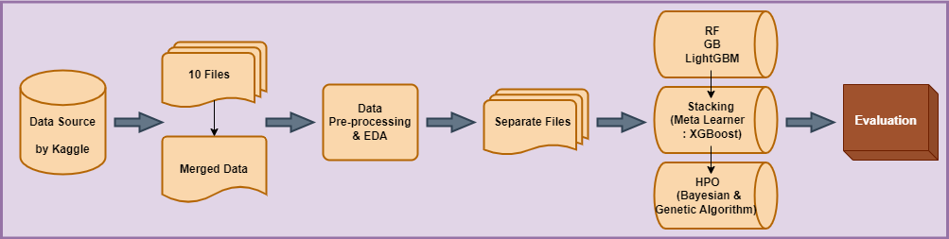
Methodology and Process Workflow
Notes:
This is the Methodology and Process Workflow.
KDD methodology was taken to work on this project.

Slide 11

Data Source and Preprocessing
Handling 'host since' column: Data cut to match 'host_since' column, rows with NA dropped.
Removing symbols: $ and % symbols removed using regular expressions.
Rectifying duplicated values: 'host listings count' and 'host total listings count' values rectified for multiple hostings by the same host.
Normalisation and mapped to percentiles: 'profitability by numOfYears' column normalised through logarithmic transformation.
Notes:
The resource of the data is from Kaggle.com
and Many different preprocessing had been applied for example Drop data, Regular expression, Normalisation

Slide 12
Data Source and Preprocessing
All data types should be converted to numeric for regression model preparation.
Encoding 'host location': 'host location' values transformed using regular expressions.
'Yes/True' encoded as 1, 'No/False' as 0, and missing values as -1.
Flattening 'host_verifications': List format data transformed through One-Hot Encoding.
Separating 'bathrooms text' into bathroom count and bathroom type columns.
Counted and re-assigned the top 100 amenity occurrences in 'amenities' column.
Encoding 'host response time' and 'room type' by Replacing values with -1 to 3.
Label encoding 'property type': Converting categorical variable into numerical format.
Dropping columns with substantial overlapped.
Replacing missing values: Filling remaining missing values with -1 using fillna() function.
Notes:
Different types of encoding functions, create new columns using by own equations and dealing with null values.

Slide 13
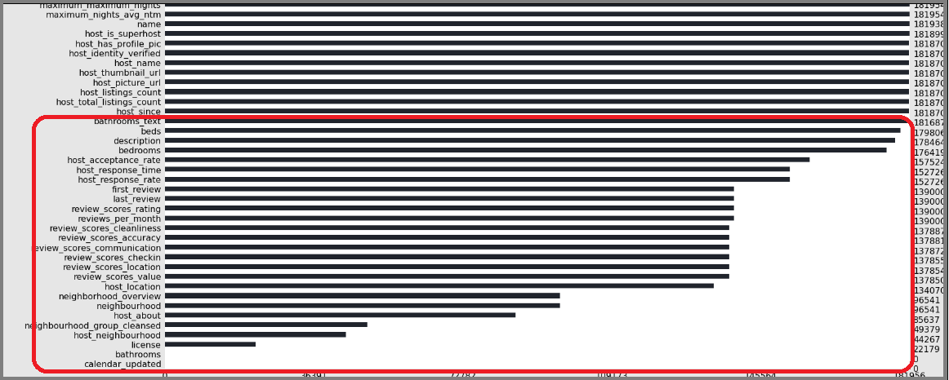
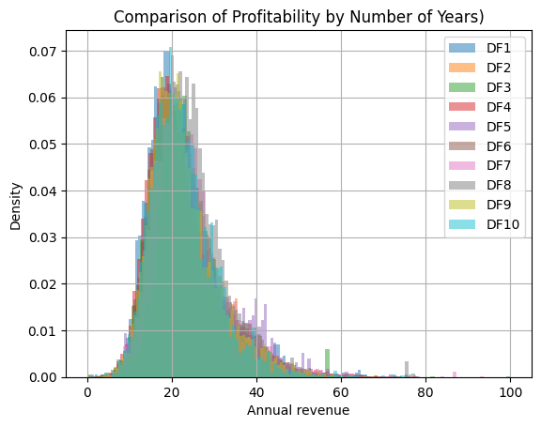
Explanatory Data Analysis and Visualisation
Notes:
To visualise the dataset used for this project, there were too many columns more than 70 and also there were many columns with null values.
The second picture is the distribution of the target values across 10 cities datasets. Looks similar but there was a Statistical significance through ANOVA test.

Slide 14
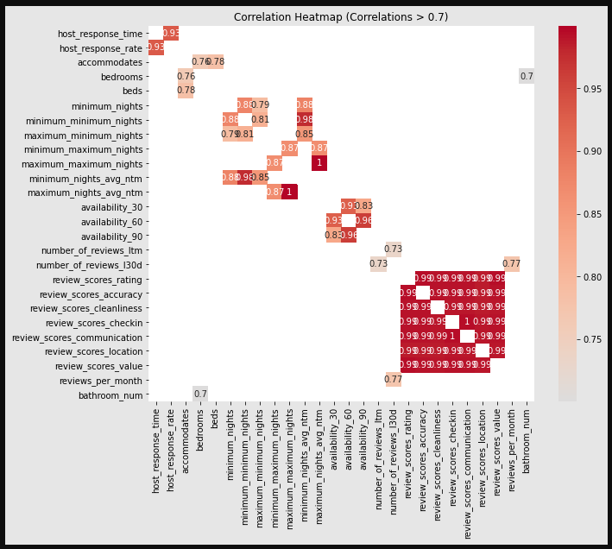
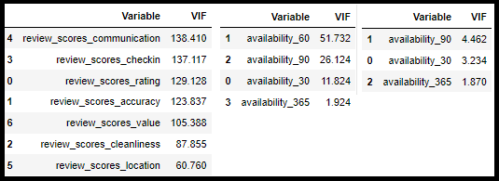
Explanatory Data Analysis and Visualisation
Notes:
Factors with high correlations with each other were removed after checking multicollinearity, which corresponds to bigger than 5 of VIF measurement.

Slide 15
Implementation
Base Learners(Random Forest, Gradient Boosting, LightGBM): By iterating over a range from 10 to 100 with increments of 10, from 10 to 200 with increments of 20 and from 15 to 300 with increments of 15, the best scores were achieved with n estimators=90 for 0.95, n estimators=190 for 0.952 and n estimators=275 for 0.953 respectively on the training dataset
Meta Learner(XGBoost): owing to the inherent functionality of XGBRegressor, more parameter adjustments were executed automatically. Among the parameters used for the best model which is the result of repeated execution, max depth, learning rate, gamma, and a number of estimators are as follows: max depth=6, learning rate=0.300000012, gamma=0, n estimators=190.
Notes:
Random Forest, Gradient Boosting and LightGBM are base learners and XGBoost is the meta-learner. For both base learners and the meta learner, 20 iterations were applied to find the best model and parameters.

Slide 16
Implementation
Ensemble Stacking: Random Forest, Gradient Boosting (GB), and LightGBM were employed as base learners, and then their predicted values were stacked comprised of new features for the meta-learner, XGBoost.
Bayesian Optimisation: The combination with Stacked model was applied by using BayesSearchCV(). The best parameters: gamm=0.7703399241440627, learning_rate=0.19204784774815406, max_depth=2, and n_estimators=764.
Genetic Algorithm: accomplished through the integration of custom-built functions and the DEAP framework. The best parameters: max depth=10, learning rate=0.3661267728814921, gamma=0.07173330604877207 and n estimators=190.
Notes:
Ensemble Stacking is combination of base learners and the meta-learner
predicted values of base learners were stacked comprised of new features for the meta-learner, XGBoost.
Bayesian Optimisation served by BayesSearchCV().
Genetic Algorithm served by pre-defined function and DEAP framework.

Slide 17
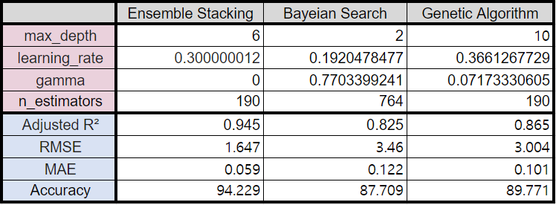
Notes:
The pink-shaded part indicates the hyperparameters from the best model of each method

Slide 18
Evaluation and Result
Random Forest: On average, the values stand at 0.59 for Adjusted-R2, 5.28 for RMSE, 0.18 for MAE, and 81.93 for Accuracy. Random Forest showed better performance than the basic Gradient Boosting model on all 10 data.
Gradient Boosting: On average, the performances stand at 0.557 for Adjusted-R2, 5.57 for RMSE, 0.194 for MAE, and 80.609 for Accuracy. Gradient Boosting showed the worst performances among the single basic models on all datasets except for Bergamo at adjusted R2 and RMSE.
LightGBM: On average, the performances stand at 0.608 for Adjusted-R2, 5.25 for RMSE, 0.179 for MAE, and 82.054 for Accuracy. Comparing LightGBM and GB, all the results of LightGBM on all datasets of 10 cities showed better performances.
XGBoost: On average, the performances stand at 0.58 for Adjusted- R2, 5.36 for RMSE, 0.18 for MAE, and 81.91 for Accuracy. XGBoost has performed better than other boosting regression tree algorithms in some datasets while other approaches have performed better than XGBoost in other datasets. Interpreting this, it can be hard to assert that XGBoost always outperforms other boosting regression techniques, contrary to the findings from related works.

Slide 19
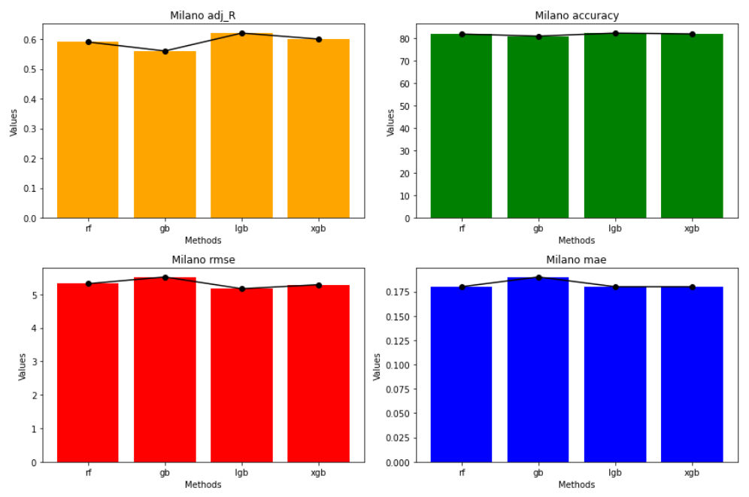
Comparison of Single Ensemble Models
Notes:
Looking at the example graphs from Milano datasets, Randomforest, LightGBM, and XGBoost have similar performance, while Gradient Boosting has a lower performance little bit. However, the difference is subtle.

Slide 20
Evaluation and Result
Ensemble Stacking: Across all datasets, any single-model approach didn’t achieve better performance than those obtained even with the lowest performance from the ensemble stacking model.
Bayesian Optimisation: The combination of the stacking model and Bayesian optimization across all 10 datasets demonstrated that the error scores for all models were higher and the Adjusted-R2 values for all models were lower compared to those of the individual Stacking model.
Genetic Algorithm: On average, the performances stand at 0.865 for Adjusted-R2, 3.004 for RMSE, 0.101 for MAE, and 89.77 for Accuracy. GA has performed better than Bayesian optimisation in all different datasets.
Notes:
The Stacking model demonstrates the highest performance, followed by the Genetic Algorithm and Bayesian Optimisation.

Slide 21
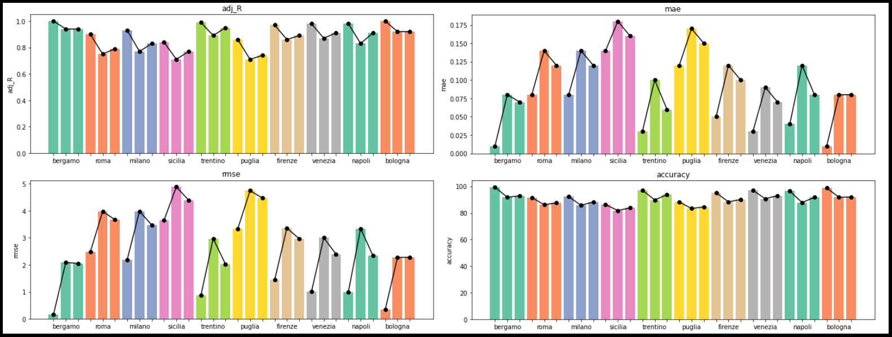
Across all data and 3 Main Approaches
Notes:
Looking at the visualisations, it is shown clear.

Slide 22
Discussion and Conclusion
Discussion
Challenges
Results
Issues and Limitation
Conclusion: Across all 10 datasets, the modelling results indicated that Random Forest, Gradient Boosting, LightGBM, and XGBoost exhibited a relatively similar trend with only minor differences in performance. However, with the application of Ensemble Stacking techniques, there was a notable surge in accuracy and a decline in error scores(RMSE, MAE). Subsequently, the model incorporating Bayesian Optimization witnessed a decrease from the previous method in performance, while the model incorporating Genetic Algorithm displayed a slightly elevated trend compared to the Bayesian approach.
Notes:
To state RQ and sub-RQ how have been answered, Ensemble Stacking Technique did a good job of predicting profitability in all datasets. This method was much better than other single ensemble models and showed better results when the Bayesian optimization or Genetic algorithm was not combined. For sub-RQ, the median value and distribution of profitability in 10 cities were somewhat similar. However, the difference could be seen as significant through the Anova test, and the most affected factors conducted after the modelling was completed were the location of the host, number of bathrooms, a total host listing, property type, number of beds, and the possibility of instant booking and so on. Among the cities, Bergamo and Bologna showed the most similarities to each other in their top 10 influential factors affecting the ensemble prediction models.

Slide 23
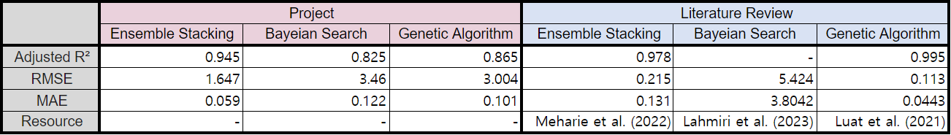
Notes:
Across all 10 datasets, the modelling results indicated that Random Forest, Gradient Boosting, LightGBM, and XGBoost exhibited a relatively similar trend with only minor differences in performance. However, with the application of Ensemble Stacking techniques, there was a notable surge in accuracy and a decline in error scores(RMSE, MAE). Subsequently, the model incorporating Bayesian Optimization witnessed a decrease from the previous method in performance, while the model incorporating Genetic Algorithm displayed a slightly elevated trend compared to the Bayesian approach.

Slide 24
Future Work
Explore more Hyperparameter Optimisation approaches
New Feature Selection: Feature selection could be attempted from a different perspective, considering that another approach can sometimes lead to substantial changes in the model's predictive power.
Different Data Sources: A wider perspective of the model's performance and robustness in various contexts is provided by expanding the project's scope by incorporating data from various sources, such as different countries or regions.
Real-world deployment: Validate the usefulness of the prediction model in real-world situations and its performance. This effort is critical to confirming the model's applicability and dependability in actual decision-making scenarios.
Notes:
Explore more Hyperparameter Optimisation approaches
A Challenge to New Feature Selection Approach
Using Different Data Sources
Real-world deployment

Slide 25
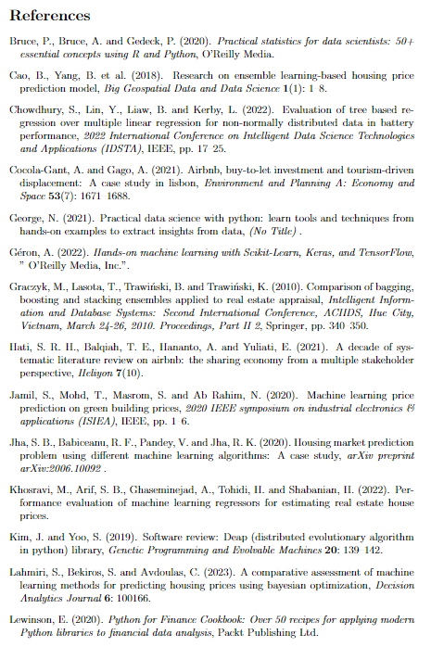
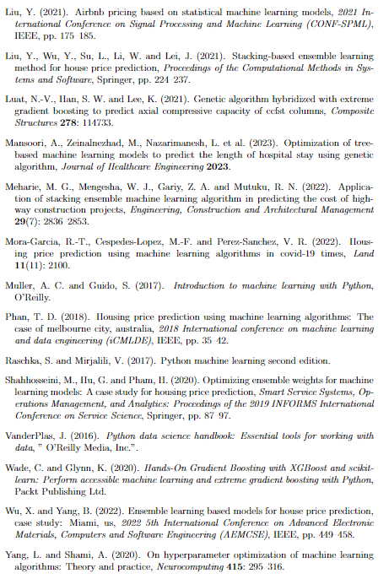
Literature Review
Notes:
These are the reviews helped my projects.

Slide 26
Thank you!

